Slide 1
Big Data

Slide 2
Measuring data
Bit | 1 bit | 1/8
Nibble | 4 bits | 1/2 (rare)
Byte | 8 bits | 1
Kilobyte | 1,024 bytes | 1,024
Megabyte | 1,024 kilobytes | 1,048,576
Gigabyte | 1,024 megabytes | 1,073,741,824
Terabyte | 1,024 gigabytes | 1,099,511,627,776
Petabyte | 1,024 terrabytes | 1,125,899,906,842,624
Exabyte | 1,024 petabytes | 1,152,921,504,606,846,976
Zettabyte | 1,024 exabytes | 1,180,591,620,717,411,303,424
Yottabyte | 1,024 zettabytes | 1,208,925,819,614,629,174,706,176

Slide 3
Byte | A single letter, like "A."
Kilobyte | A 14-line e-mail. A pretty lengthy paragraph of text.
Megabyte | A good sized novel. Shelley's "Frankenstein" is only about four-fifths of a megabyte.
Gigabyte | About 300 MP3s. About 40 minutes of video at DVD quality (this varies, depending on maker). A CD holds about three-fourths of a gigabyte.
Terabyte | About thirty and a half weeks worth of high-quality audio. Statistically, the average person has spoken about this much by age 25.
Petabyte | The amount of data available on the web in the year 2000 is thought to occupy 8 petabytes.
Exabyte | In a world with a population of 3 billion, all information generated annually in any form would occupy a single exabyte. Supposedly, everything ever said by everyone who is or has lived on the planet Earth would take up 5 exabytes.
Zettabyte | Three hundred trillion MP3s; Two hundred billion DVDs. If every person living in the year 2000 had had a 180 gigabyte hard drive filled completely with data, all the data on all those drives would occupy 1 zettabyte.
Notes:
3

Slide 4
Growth of Data
IDC estimates
4.4 zettabytes in 2013 (zettabytes = 10²¹)
44 zettabytes in 2020

Slide 5
Sources of Big Data
Facebook: 7 petabytes per month
NYSE: 4 to 5 terabytes per day
Ancestry.com stores around 10 petabytes
The Internet Archive stores around 18.5 petabytes of data
Hadron Collider 30 petabytes per year
PB datasets are rapidly becoming the norm, and the trends are clear: our ability to store and process data is fast overwhelming

Slide 6
Fundamental Data characteristic
Unstructured Data (vs. Structured Data)
Volume (Huge amount of data)
Data is in digital format
Challenge is to make sense out of it. That is termed as Big Data Analytics

Slide 7
Fundamental Data characteristic
Volume
Velocity
Variety
Veracity
Also known as 4 V’s.
Consider
Challenges and Values

Slide 8
Volume-based value: The more comprehensive your integrated view of the customer and the more historical data you have on them, the more insight you can extract from it. In turn, you are making better decisions when it comes to acquiring, retaining, growing and managing those customer relationships.
Velocity-based value: The more rapidly you can process information into your data and analytics platform, the more flexibility you get to find answers to your questions via queries, reports, dashboards, etc. A rapid data ingestion and rapid analysis capability provides you with the timely and correct decision achieve your customer relationship management objectives.
Variety-based value: The more varied customer data you have – from the Customer relationship management (CRM) system, social media, call-center logs, etc. – the more multifaceted view you develop about your customers, thus enabling you to develop customer journey maps and personalization to engage more with customers.
Veracity-based value: Amassing a lot of data does not mean the data becomes clean and accurate. Data on customers must remain consolidated, cleansed, consistent, and current to make the right decisions.

Slide 9
BIG IDEAS
Tackling large-data problems requires a distinct approach that sometimes runs counter to traditional models of computing.
All of these ideas have been discussed in the computer science literature for some time (some for decades), and MapReduce is certainly not the 1st to adopt these ideas.
Google deserve tremendous credit for pulling these various threads together and demonstrating the power of these ideas on a scale previously unheard of.

Slide 10
1. Scale out, not up
For data-intensive workloads, a large number of commodity low-end servers (i.e., the scaling out approach) is preferred over a small number of high-end servers (i.e., the scaling up approach).
The latter approach of purchasing symmetric multi-processing (SMP) machines with a large number of processor sockets (dozens, even hundreds) and a large amount of shared memory (hundreds or even thousands of gigabytes) is not cost effective, since the costs of such machines do not scale linearly (i.e., a machine with twice as many processors is often significantly more than twice as expensive).

Slide 11
2. Assume failures are common
At warehouse scale, failures are not only inevitable, but commonplace.
Problem 1
Assume that a 10000 server cluster is built from reliable machines with a mean-time between failures (MTBF) of 1000 days
(a) What is the failure rate?
(b) If MTBF of a machine is 10000 days, what is the failure rate?

Slide 12
Assume failures are common
Let us suppose that a cluster is built from reliable machines with a mean-time between failures (MTBF) of1000 days (about three years). Even with these reliable servers, a 10,000-server cluster would still experience roughly 10 failures a day.
For the sake of argument, let us suppose that a MTBF of 10,000 days (about thirty years) were achievable at realistic costs (which is unlikely). Even then, a 10,000-server cluster would still experience one failure daily.

Slide 13
3. Move processing to the data
In traditional high-performance computing (HPC) applications (e.g., for climate or nuclear simulations), it is commonplace for a supercomputer to have processing nodes and storage nodes linked together by a high-capacity interconnect.
Many Big Data workloads are not very processor-demanding, which means that the separation of compute and storage creates a bottleneck in the network.

Slide 14
Move processing to the data
As an alternative to moving data around, it is more efficient to move the processing around.
That is, MapReduce assumes an architecture where processors and storage (disk) are co-located.
In such a setup, we can take advantage of data locality by running code on the processor directly attached to the block of data we need.
The distributed file system (DFS) is responsible for managing the data over which MapReduce operates.

Slide 15
4. Process data sequentially and avoid random access
Data-intensive processing by definition means that the relevant datasets are too large to fit in memory and must be held on disk.
Seek times for random disk access are fundamentally limited by the mechanical nature of the devices: read heads can only move so fast and platters can only spin so rapidly. As a result, it is desirable to avoid random data access, and instead organize computations so that data is processed sequentially.

Slide 16
5. Hide system-level details from the application developer
Writing code is difficult is because the programmer must simultaneously keep track of many details in short term memory.
Short-term memory (or "primary" or "active memory") is the capacity for holding a small amount of information in mind in an active, readily available state for a short period of time. The duration of short-term memory (when rehearsal or active maintenance is prevented) is believed to be in the order of seconds. A commonly cited capacity is 7 ± 2 elements. In contrast, long-term memory can hold an indefinite amount of information.

Slide 17
6. Seamless scalability
For data-intensive processing, it goes without saying that scalable algorithms are highly desirable.

Slide 18
Why DFS
Problem 2
Read 1 TB data
1 machine having 4 I/O channels ( or 4 hard drives) such that each can read 100 MB/sec.
10 machine having each having 4 I/O channels ( or 4 hard drives) such that each can read 100 MB/sec.

Slide 19
Why DFS
Read 1 TB data
1 machine
4 I/O channels (4 hard drives)
Each 100 MB/sec
1000000 MB/400 MB = 41.666 minutes
10 machine
4 I/O channels
Each 100 MB/sec
1000000 MB/4000 MB = 4.1666 minutes
I/O speed is the challenge; not the storage capacity. So we need to distribute data among many nodes (machines)

Slide 20
What is DFS
Machines are physically located at different places
Logically, there is only one file system
So we can read data in parallel into multiple machines

Slide 21
What is Hadoop 1.x
Definition
Hadoop is a framework that allows for distributed processing of large data sets across clusters of commodity computers using a simple computing model (called MapReduce to retrieve and analyze data).
Google, Yahoo, IBM, LinkedIn, Facebook, eBay, Amazon, …

Slide 22
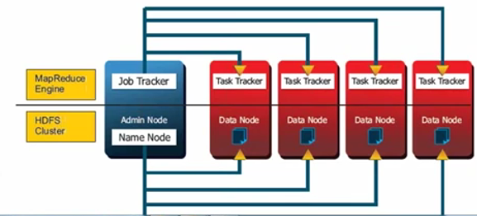
Hadoop 1.x
HDFS (Hadoop Distributed File System) for storage
MapReduce for processing

Slide 23
HDFS
Definition
HDFS is a file system designed for storing very large files (petabytes or hundreds of terabytes) with streaming data access patterns, running clusters on commodity hardware.

Slide 24
HDFS
Highly fault-tolerant (replication of data in multiple nodes)
High throughput (yahoo uses 5000 nodes)
Suitable for applications with very large data sets
Streaming access to file system data
Write once and read many times.
Where getting the entire data faster is more important than getting a specific record.
Can be built out of commodity hardware

Slide 25
HDFS is not suitable for
Low-latency data access
latency: time interval between data request and data availability.
HDFS is optimized for high throughput of data at the expense of high latency
Lots of small files
Because name node stores filesystem metadata in memory. Each file, directory, block takes about 150 bytes
Multiple writers or file modification at arbitrary offsets
Might be supported in the future but relatively inefficient

Slide 26

HDFS components
NameNode
DataNode
Note 1. NameNode, DataNode, Job Tracker and Task Tracker are demons*
Note 2. Job Tracker and Task Tracker are in Hadoop 1.x and are NOT IN Hadoop 2.0 and up.
Img Ref: https://hadoop.apache.org/docs/r1.2.1/hdfs_design.html
*demon: a service or process that runs in the background in unix environment

Slide 27
NameNode
Master of the system
Single Point of Failure (SPoF)
Very expensive hardware with double/triple redundancy (RAID*)
Responsibility: manages the filesystem namespace
maintains the filesystem tree and the metadata for all the files
maintains and manages the blocks that are present on DataNodes
*RAID (Redundant Array of Independent Disks) is a storage technology that combines multiple disk drive components into a logical unit for the purposes of data redundancy and performance improvement.

Slide 28
DataNode
Slaves which are deployed on each machine to provide the actual storage
Responsible for serving the read and write requests from the clients or namenode
Datanodes report back to the namenode periodically with lists of blocks that they are storing

Slide 29
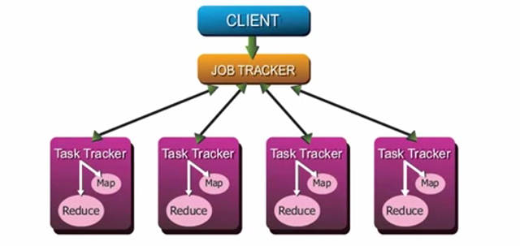
Job Tracker and Task Tracker (Hadoop 1.x) (We will cover Hadoop 2.0 in Lesson 2)

Slide 30
HDFS Architecture
A file in HDFS is broken into block-sized chunks, which are stored as independent units.
Minimum Block size is 128MB (default in linux is 8KB)
A file in HDFS that is smaller than a single block does not occupy a full block’s storage space.
Example: A 1 MB file stored with block size of 128 MB uses 1 MB of disk space, not 128 MB.

Slide 31
Large block size: pros and cons
Minimizes the cost of seeks. If the block is large enough, the time to transfer the data from the disk can be significantly larger than the time to seek to the start of the block.
MapReduce tasks operate on one input-split (see next slide to see how input-split is related to a block) at a time. So if data is not distributed into many datanodes, we are not taking advantage of the parallelism possible to its fullest extend.

Slide 32
Input-Splits
Example. Assume the following:
data block size is 64 KB.
file size is 150 KB. 15 records; each of size 10 KB.
Now the file is stored in three data blocks:
0 – 63 KB in the first block, 64 – 127 KB in the second block, 128 – 149KB in the third block.
0-6 records are in the 1st input-split (0 – 69 KB) (the 1st split actually extends beyond the 1st block and gets the remaining record from block 2)
7-12 records are in the 2nd input-split (70 -129 KB)
13 and 14 records are in the 3rd input-split (130 - 149 KB)

Slide 33
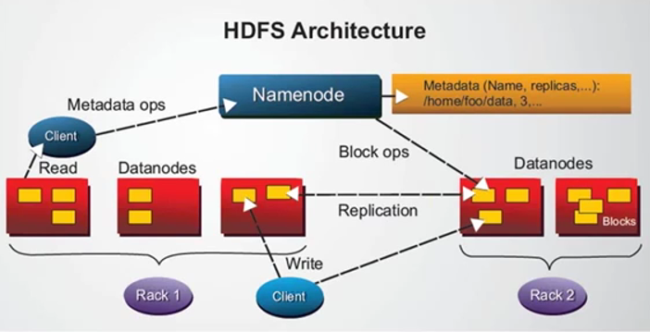
HDFS Architecture
Read and Write

Slide 34
HDFS
Anatomy of file read
The client starts with calling open() on the HDFS.
HDFS calls the namenode, using remote procedure calls (RPCs), to determine the locations of the first few blocks. For each block, the namenode returns the addresses of the datanodes that have a copy of that block. Datanodes are sorted according to their proximity to the client.
The HDFS returns a DFSInputStream that supports file seeks to the client for it to read data.

Slide 35
HDFS
Anatomy of file read
The client then calls read() on the DFSInputStream which has stored the datanode addresses for the first few blocks in the file, then connects to the first (closest) datanode for the first block in the file. Data is streamed from the datanode back to the client, which calls read() repeatedly on the DFSInputStream. When the end of the block is reached, DFSInputStream will close the connection to the datanode and then find the best datanode for the next block. This happens transparently to the client (From the client point of view, it as reading a continuous stream.).

Slide 36
HDFS
Anatomy of file read
Blocks are read in order. It also call the namenode to retrieve datanode locations for next batch of blocks as needed. When the client has finished reading, it calls close() on the DFSInputStream.
During reading, if an error occurs, it will try the next closed datanode for the same block. It will remember the failed datanode so that it won’t retry the same datanode for a different block.

Slide 37
HDFS
Anatomy of file read
Important aspect: Client contacts datanode directly to retrieve data and is guided by the namenode to the best datanode for each block.

Slide 38
HDFS
Anatomy of file write
The client creates the file by calling create() on HDFS.
HDFS makes an RPC call to the namenode to create a new file in the filesystem’s namespace with no blocks associated with it. The namenode checks to make sure file doesn’t already exist and client has the permission to create a new file. HDFS returns a DFSOutputStream to the client so that client can start writing data.
As the client writes data, the DFSOutputStream splits it into packets and written into an internal queue called data queue.

Slide 39
Anatomy of file write
The data queue is consumed by the DataStreamer, which is responsible for asking the namenode to allocate new blocks by picking a list of suitable datanodes to store the replicas. The list of datanodes form a pipeline and if the replication level is 3, there will be three nodes in the pipeline. The DataStreamer streams the packets to the first datanode in the pipeline which stores each packet and forwards it to the second datanode in the pipeline. The second datanode in the pipeline stores each packet and forwards it to the third (and the last) datanode in the pipeline.

Slide 40
HDFS
Anatomy of file write
The DFSOutputStream also maintains an internal queue, called ack queue, of packets that are waiting to be acknowledged by datanodes. A datanode is removed from ack queue only when it has been acknowledged by all datanodes in the pipeline.
If any datanode fails while data is being written to it, then the following actions are taken, which are transparent to the client writing the data. First, the pipeline is closed, and any packets in the ack queue

Slide 41
HDFS
Anatomy of file write
The DFSOutputStream also maintains an internal queue, called ack queue, of packets that are waiting to be acknowledged by datanodes. A datanode is removed from ack queue only when it has been acknowledged by all datanodes in the pipeline.
If any datanode fails while data is being written to it, then the following actions are taken, which are transparent to the client writing the data. First, the pipeline is closed, and any packets in the ack queue

Slide 42
HDFS
Anatomy of file write
are added to the front of the data queue so that datanodes that are downstream from the failed node will not miss any packets. The namenode is informed about the failure so that proper actions can be taken.
When the client has finished writing data, it calls close() on the DFSOutputStream.

Slide 43
Secondary NameNode
NameNode keeps all the data in the RAM. Secondary NameNode Reads data from the RAM of the NameNode and writes into hard drive. In Hadoop 1.x Secondary NameNode will not become (Primary) NameNode if the NameNode fails.

Slide 44
Replication
By default, HDFS stores three separate copies of each data block to ensure both reliability, availability, and performance. In large clusters, the three replicas are spread across two different physical racks, so HDFS is resilient towards two common failure scenarios: individual datanode crashes and failures in networking equipment that bring an entire rack offline. Replicating blocks across physical machines also increases opportunities to co-locate data and processing in the scheduling of MapReduce jobs, since multiple copies yield more opportunities to exploit locality.

Slide 45
Replication level
The namenode is in periodic communication with the datanodes to ensure proper replication of all the blocks: if there aren't enough replicas (e.g., due to disk or machine failures or to connectivity losses due to networking equipment failures), the namenode directs the creation of additional copies; if there are too many replicas (e.g., a repaired node rejoins the cluster), extra copies are discarded.

Slide 46
HDFS namenode responsibilities
Maintaining overall health of the file system. The namenode is in periodic contact with the datanodes via heartbeat messages to ensure the integrity of the system. If the namenode observes that a data block is under-replicated (fewer copies are stored on datanodes than the desired replication factor), it will direct the creation of new replicas. Finally, the namenode is also responsible for rebalancing the file system. During the course of normal operations, certain datanodes may end up holding more blocks than others; rebalancing involves moving blocks from datanodes with more blocks to datanodes with fewer blocks. This leads to better load balancing and better disk utilization.

Slide 47
HDFS (or GFS) environment
Stores a relatively modest number of large files. In HDFS multi-gigabyte files are common (and even encouraged). There are several reasons why lots of small files are to be avoided. Since the namenode must hold all file metadata in memory, this presents an upper bound on both the number of files and blocks that can be supported. Large multi-block files represent a more efficient use of namenode memory than many single-block files (each of which consumes less space than a single block size). In addition, mappers in a MapReduce job use individual files as a basic unit for splitting input data.

Slide 48
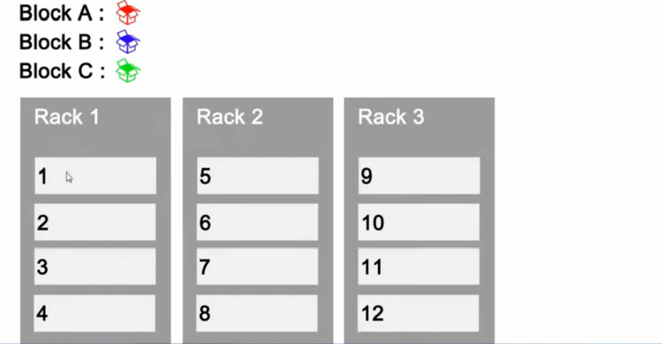
Three data blocks (A, B, C), three racks and each rack has 4 name nodes

Slide 49
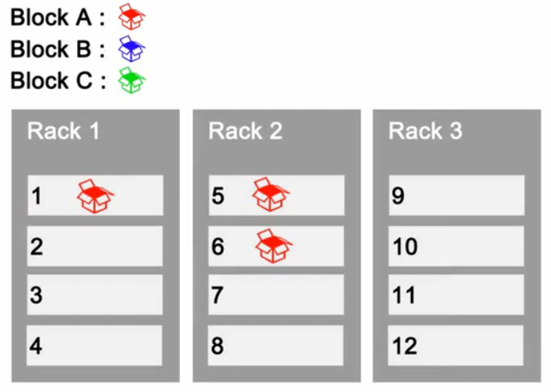
After placing Block A

Slide 50
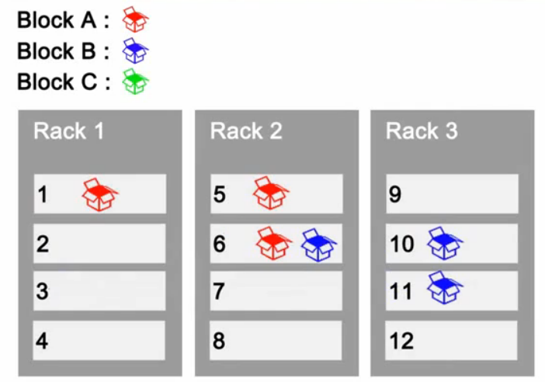
After placing Block B

Slide 51
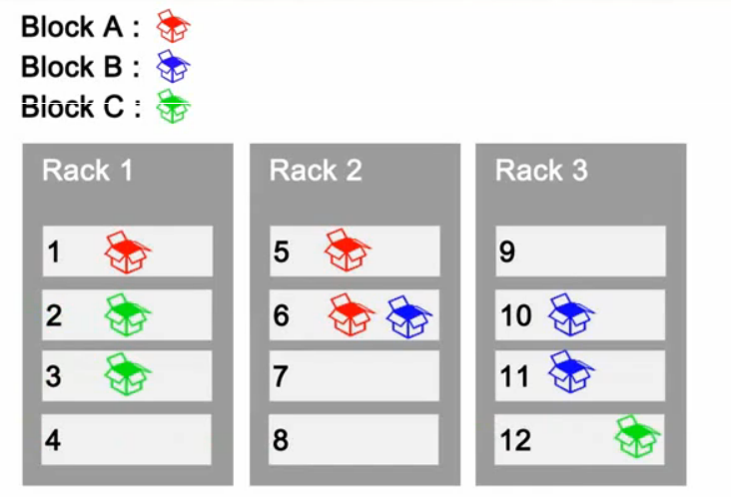
After placing Blocks A, B and C

